Slide 1

Analyses of genome data
Maria Izabel Cavassim Alves

Slide 2
Learning goals
At the end of this workshop, you will be able to:
Describe what a variant calling file (VCF) format is and how to manage those files.
Conduct quality assessment of a VCF.
Learn about population structure and how to compute it with PLINK.
Learn about linkage disequilibrium and how to compute it with PLINK.
Learn about basic association testing and genome wide association studies (GWAS).
Learn about copy number variants (CNVs) and how to test for common CNVs across individuals.
Discuss original literature within the subjects.

Slide 3
Assignment instructions
All assignments will be posted on this github page:
https://github.com/izabelcavassim/Analyses_of_genome_data
Under the “Assignments” folder
Students are required to send an e-mail to me with their assignments:
izabelcavassim@gmail.com, no later than the end of the week (Friday 12/03/2021)
If you have any questions, doubts, trouble with any of the analyses please do not hesitate to contact me!

Slide 4

Introductions
Your name (or nickname)
Your Department
What you want to learn in this workshop
What you like doing in your free time

Slide 5
Day 1
Background lecture (45 minutes)
What is a VCF?
What is QC, and why is it so important?
Break (15 minutes)
Hands on exercise (1 hour)
VCF Data management (read, recode, reorder, merge, subset, compress data)
QC assessment
Break (15 minutes)
Paper discussion on quality control assessment (30 minutes)
Assignment explanation (15 minutes)

Slide 6
Day 2
Background lecture (45 minutes)
What is population structure?
What is linkage disequilibrium?
How does population structure and LD affect association mapping?
Break (15 minutes)
Hands on exercise (1 hour)
Population stratification detection
LD estimation
Break (15 minutes)
Paper discussion on genome wide association studies
Assignment explanation (15 minutes)

Slide 7
Day 3
Peer review of previous assignment (15 minutes)
Background lecture (45 minutes)
What is association testing and GWAS?
What is a Manhattan plot and a Q-Q plot?
What is a copy number variant?
Break (15 minutes)
Hands-on exercise (1 hour and 30 minutes)
Basic association testing
GWAS accounting for population structure
CNV detection
Break (15 minutes)
Assignment explanation (15 minutes)

Slide 8
Analyses of genome data Day 1 Tuesday, 30 November 2021
Maria Izabel Cavassim Alves

Slide 9
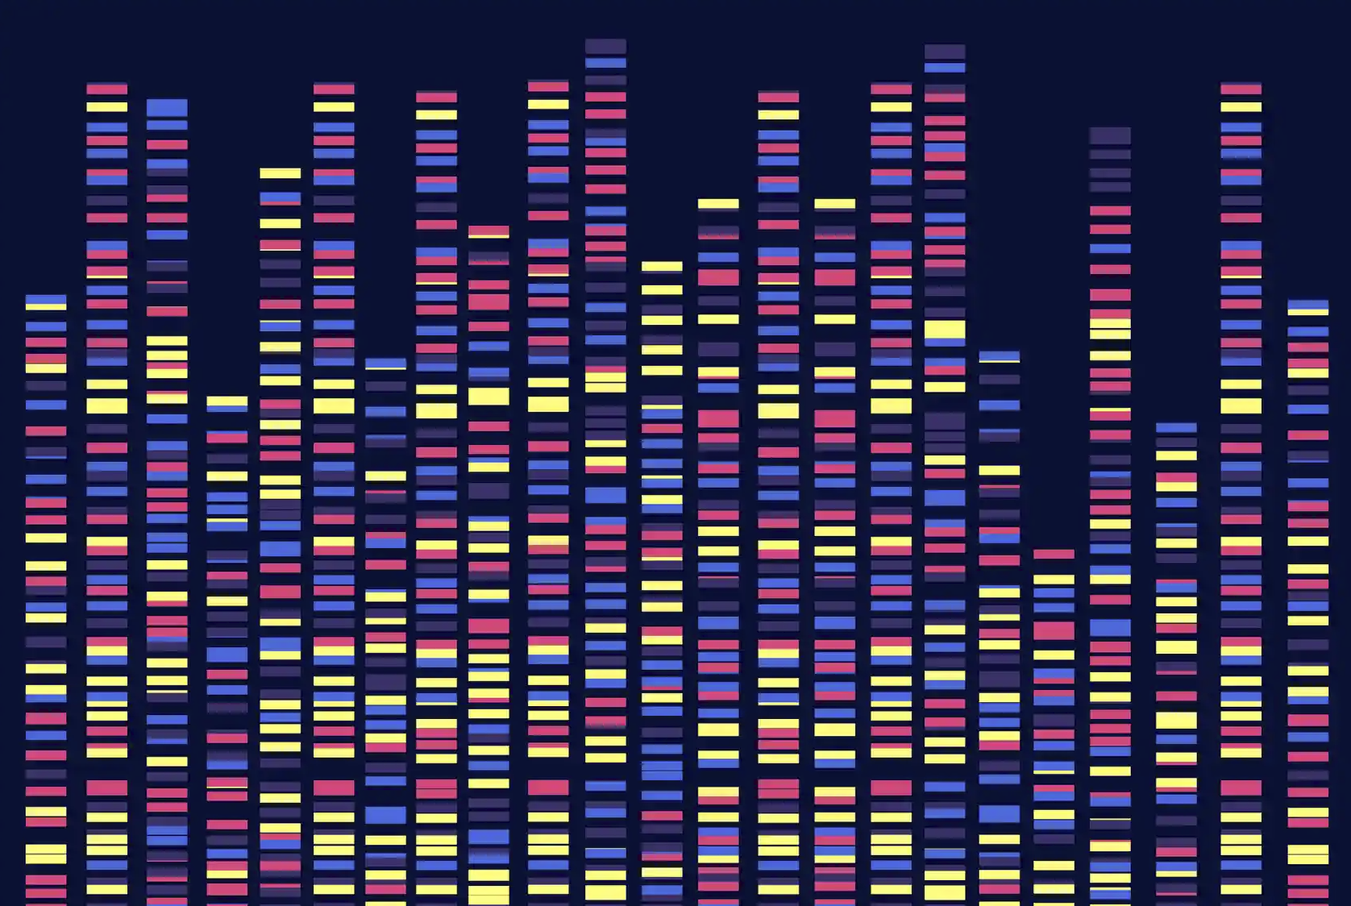
Day 1
Analyses of genome data:
What is a VCF file?
Why do we care about analyzing
Genomes?

Slide 10
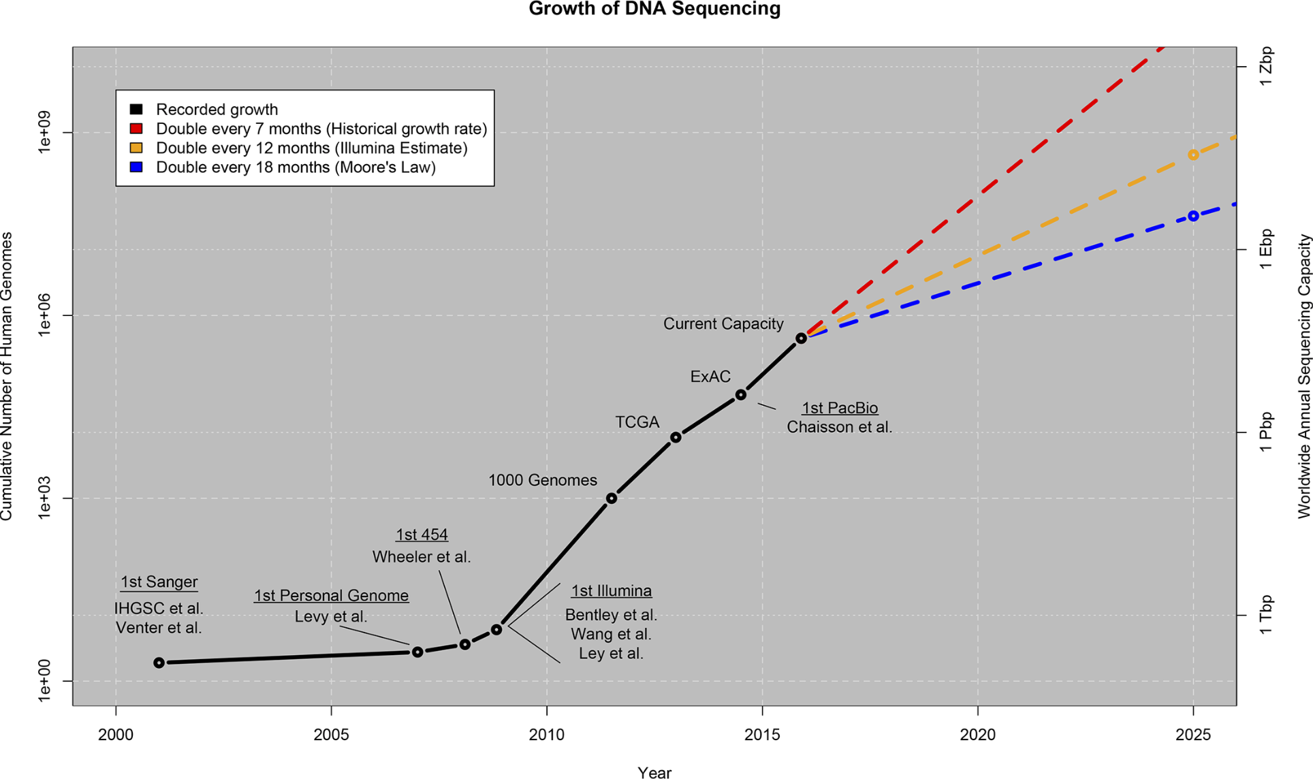
Genome data beyond human sequences is growing!
Stephens et al., 2015

Slide 11
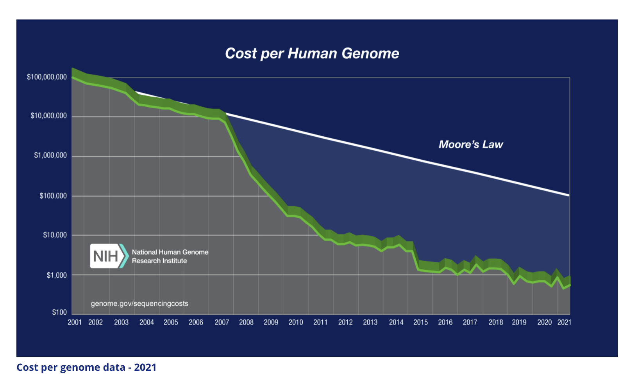
Sequencing is becoming cheaper and cheaper!

Slide 12
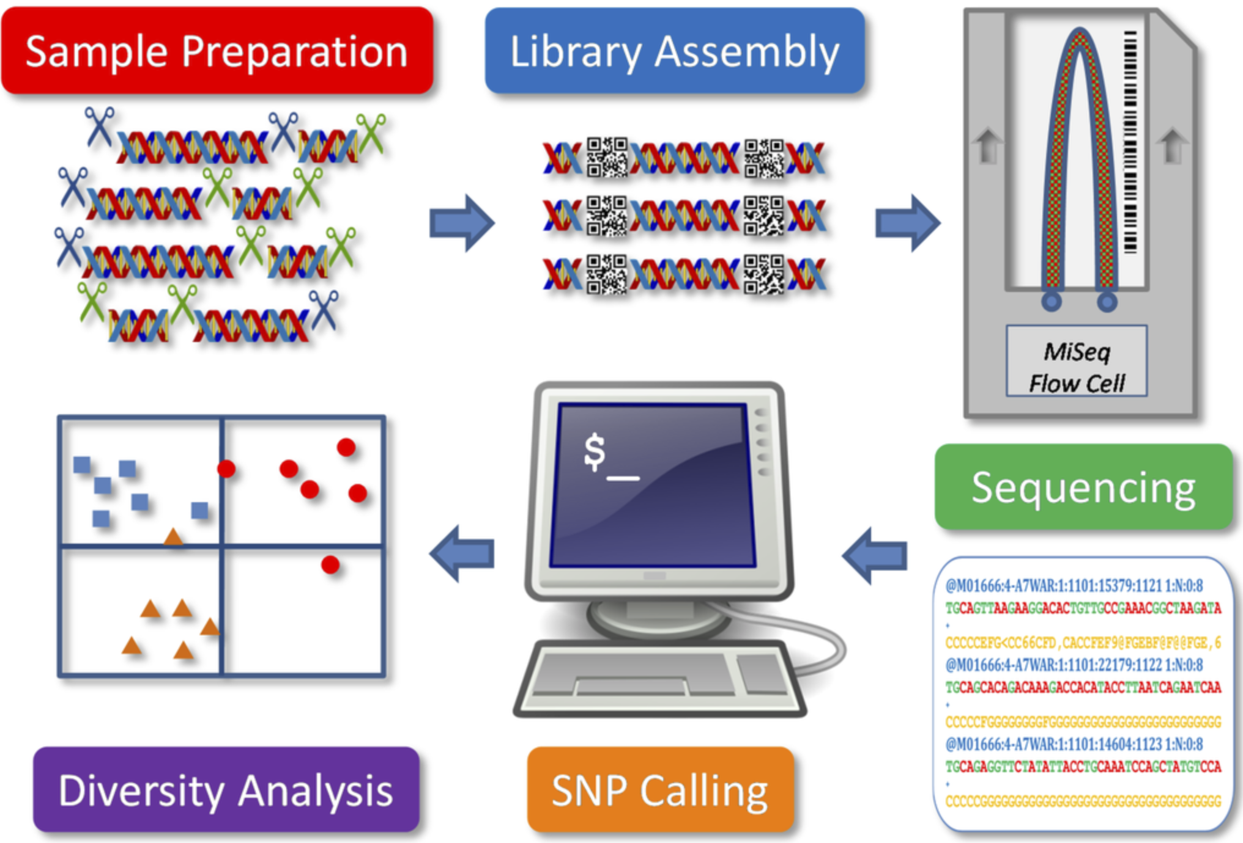
How is the SNP data generated?
Peterson et al., 2014
Notes:
Figure 1. Schematic presentation of a genotype-by-sequencing application for genetic diversity analysis. Five components are illustrated.

Slide 13
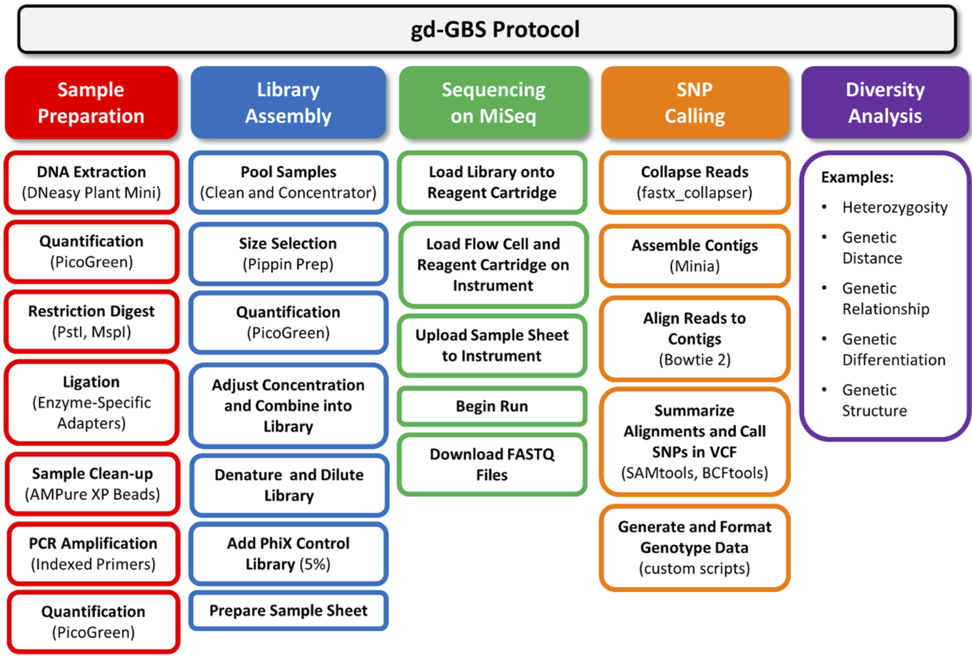
How is the SNP data generated?
Peterson et al., 2014
Notes:
Flow chart of the genetic diversity-focused genotyping-by-sequencing (gd-GBS) protocol. The gd-GBS protocol consists of five major parts and many steps. Each part (filled box) relates back to the components in Figure 1. Arranged in columns beneath each part are the ordered major steps in outlined boxes of the same colour. Bracketed terms refer to specific equipment, reagents, kits or software used.

Slide 14
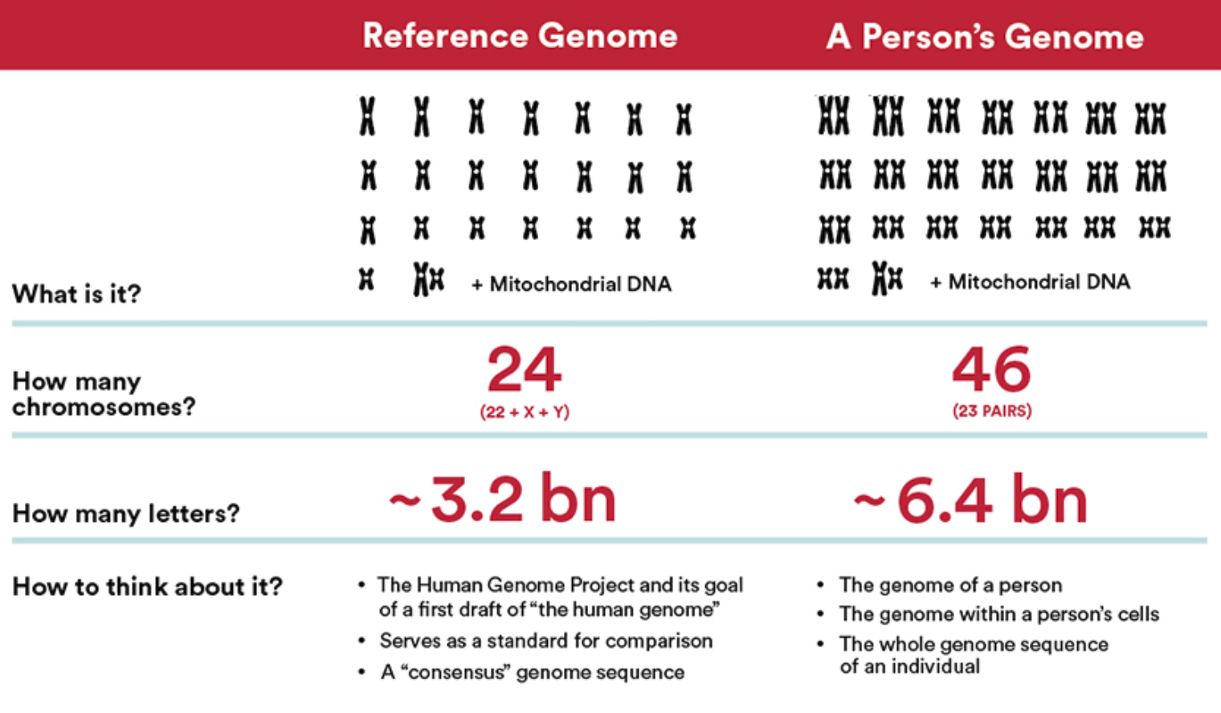
Genome (Human)

Slide 15
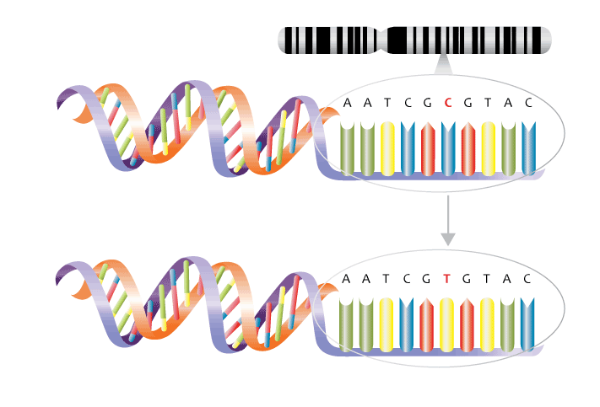
What can we do with a reference genome?
We can identify mutations, specifically we can identify Single Nucleotide Polymorphisms!!!
Reference genome
One single mutation
Your genome

Slide 16
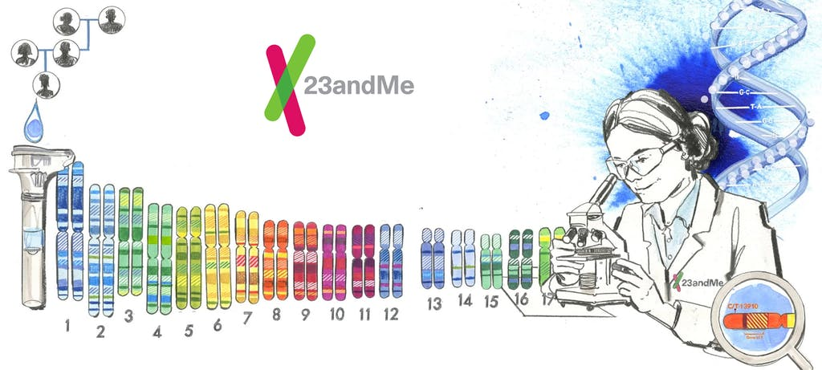
What can we learn from SNPs? A lot!!

Slide 17
Let’s make this question interactive!
https://docs.google.com/document/d/1F2k2Gw2NGMdCLOgfOTfXwpp6rFI9MYf7kCjIt1XgsJk/edit?usp=sharing

Slide 18
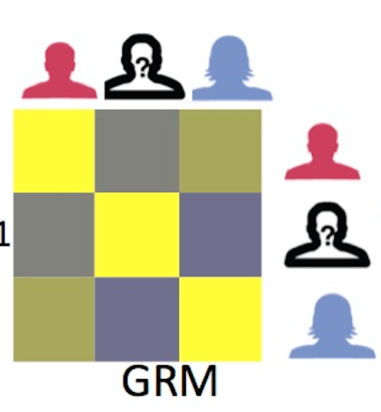
What can we learn from this SNPs? A lot!!
Are there related individuals in the sample?
Relatedness among individuals can be computed based on the average proportion of alleles shared in common at genotyped SNPs
Cavassim et al., 2020
Notes:
A basic feature of standard population-based case-control association studies is that all samples are unrelated (i.e., the maximum relatedness between any pair of individuals is less than that of a second-degree relative).

Slide 19
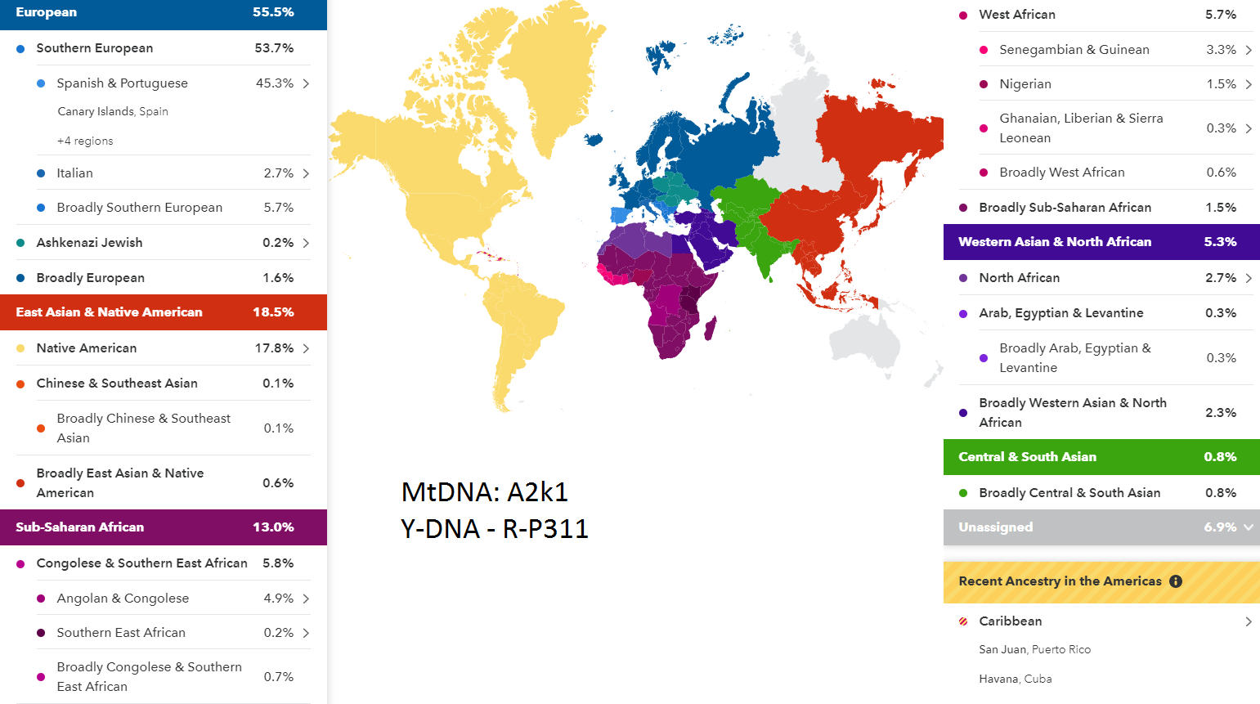
What can we learn from SNPs? A lot!!
What is an individual ancestry?

Slide 20
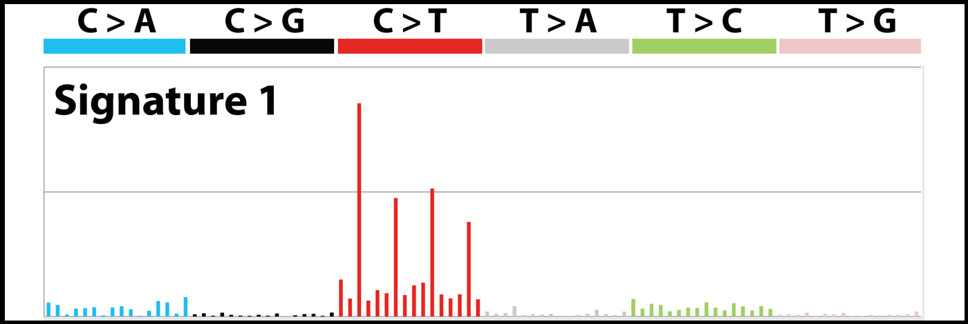
What can we learn from SNPs? A lot!!
What are the mutational patterns in cancer?

Slide 21
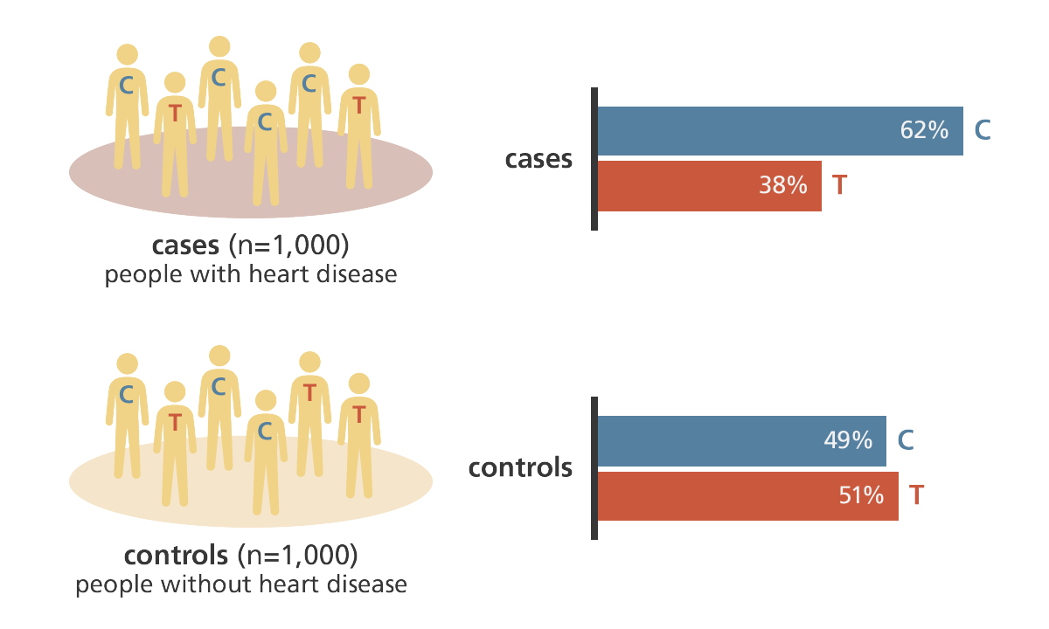
What can we learn from this SNPs? A lot!!
Is that C/T SNP associated with a higher risk for a really nasty disease?
This is also called Genome Wide Association
Studies (GWAS)

Slide 22
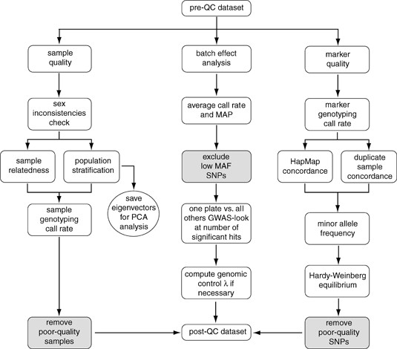
What are the first steps one needs to take once the SNP data is generated?
Turner et al., 2011

Slide 23
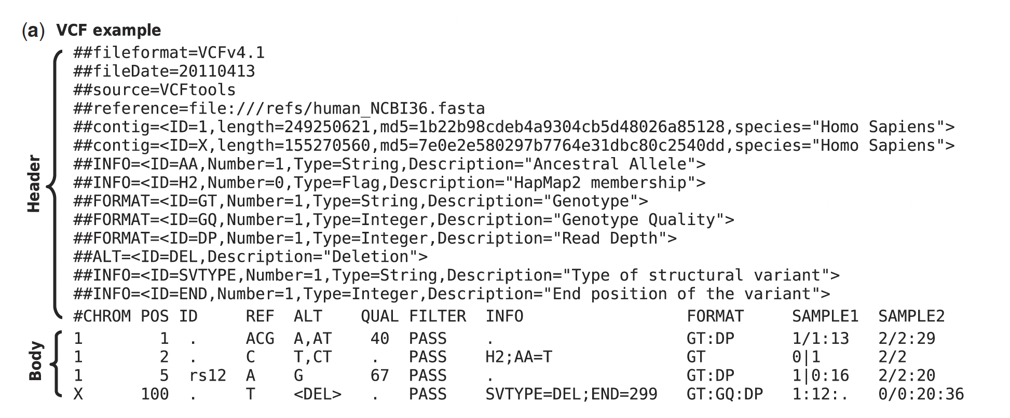
Variant Call Format

Slide 24
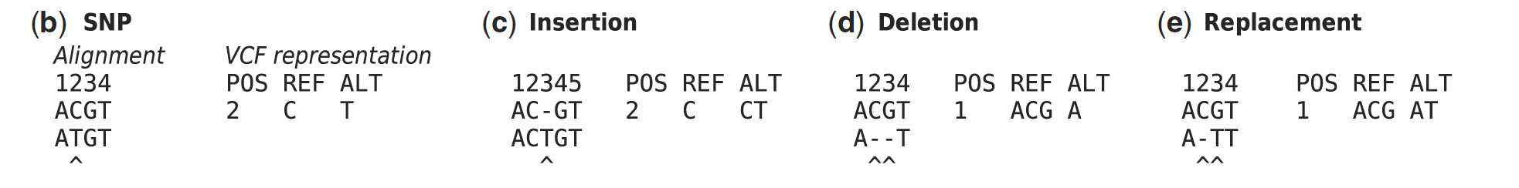
VCF format

Slide 25

15 minutes break!

Slide 26
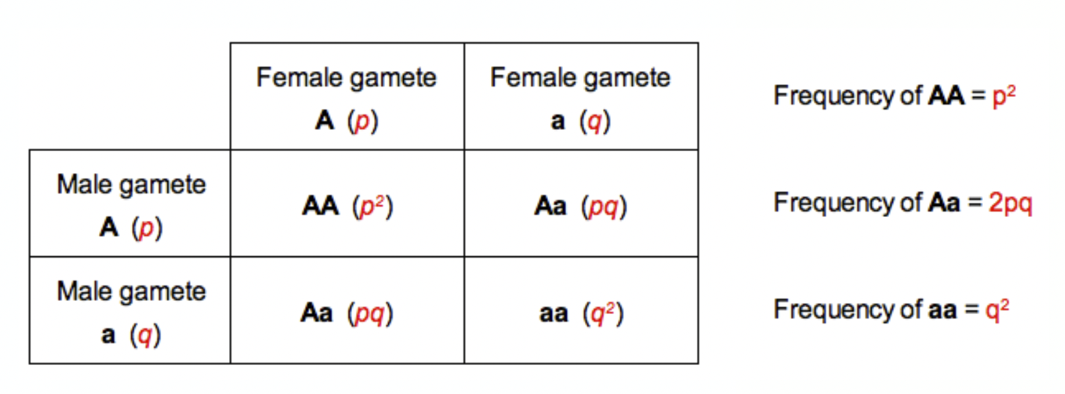
Hardy-Weinberg Equilibrium
Imagine a genetic variant with two alleles called A and a and assume that there is random mating in the population.
q^2 + p^2 + 2pq = 1

Slide 27
Deviations from Hardy-Weinberg Equilibrium
Can be a result of multiple factors:
Migration
Selection
Mutation
Non-random mating
A large deviation from Hardy-Weinberg Equilibrium could also be driven by bad data quality.

Slide 28
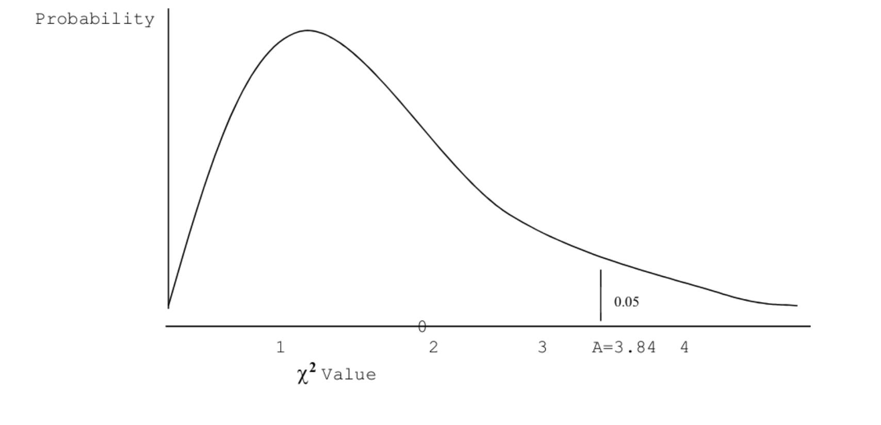
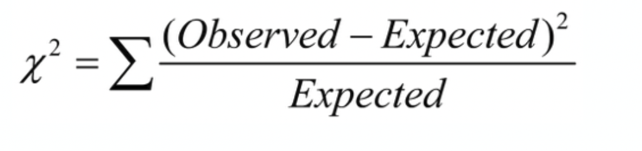
How do we compute deviations from Hardy-Weinberg Equilibrium?
With a Chi-square test!
Chi-square distribution
Critical value
If we sample 100 individuals and observe:
• 50 AA genotypes,
• 30 Aa individuals
• 20 aa individuals
You can reject the null hypothesis (alleles are in HWE) if the static for the test is greater than the critical value.

Slide 29
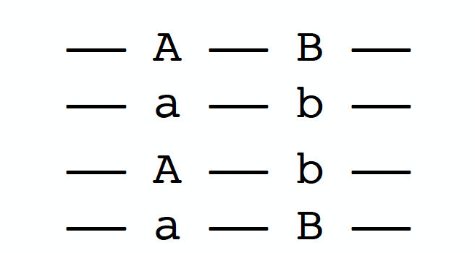
Linkage disequilibrium (LD)
• Definition:
Is the correlation between genotypes of nearby markers
• Given two variants A/a and B/b there are four different haplotypes:
• LD means that:
f(A-B) ≠ f(A) X f(B)

Slide 30
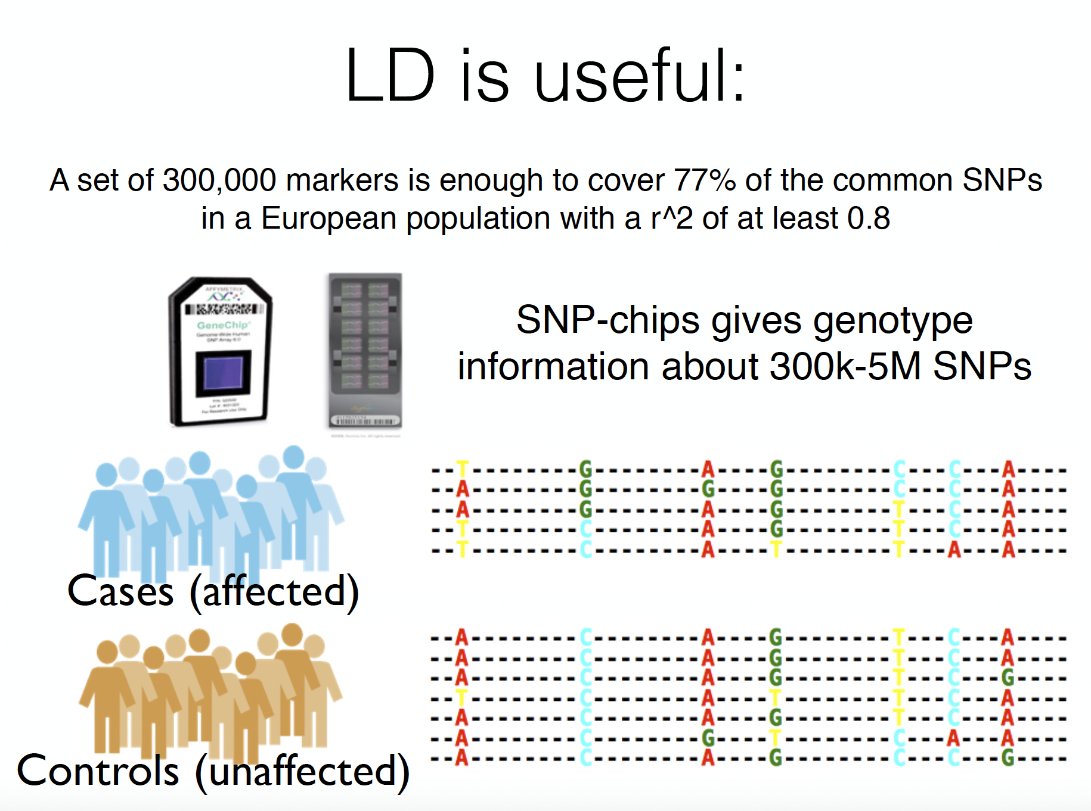
Why do we care about LD when doing GWAS?
LD can be informative:

Slide 31
Why do we care about LD when doing GWAS?
LD can also lead to redundant information
If two SNPs are non-independent (eg. are in LD), they would contribute twice for the same GWAS.
GWAS works best when using independent SNPs
Therefore, we need to ”LD prune” the data

Slide 32
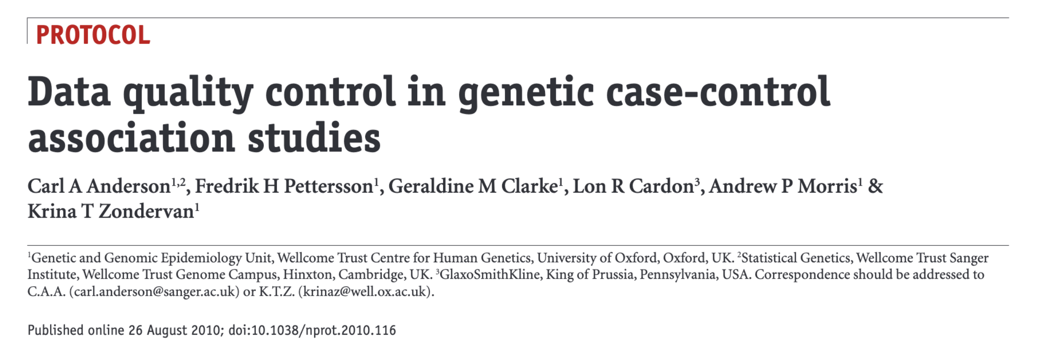
Practical exercise (Assignment 1 - QC)
We will be following the tutorial for Quality Control of genomic data by Anderson et al 2010:
To find the assignment go to:
https://github.com/izabelcavassim/Analyses_of_genome_data/tree/main/Assignments

Slide 33
Practical exercise (Assignment 1 - QC)
To get started we need to:
Access the Hoffman cluster
Install Plink on the cluster
Install R and R studio on your machine
Download the R markdown version of the assignment here:
Read the paper while doing the exercise
For this exercise we will not work with the VCF format but the PLINK format

Slide 34
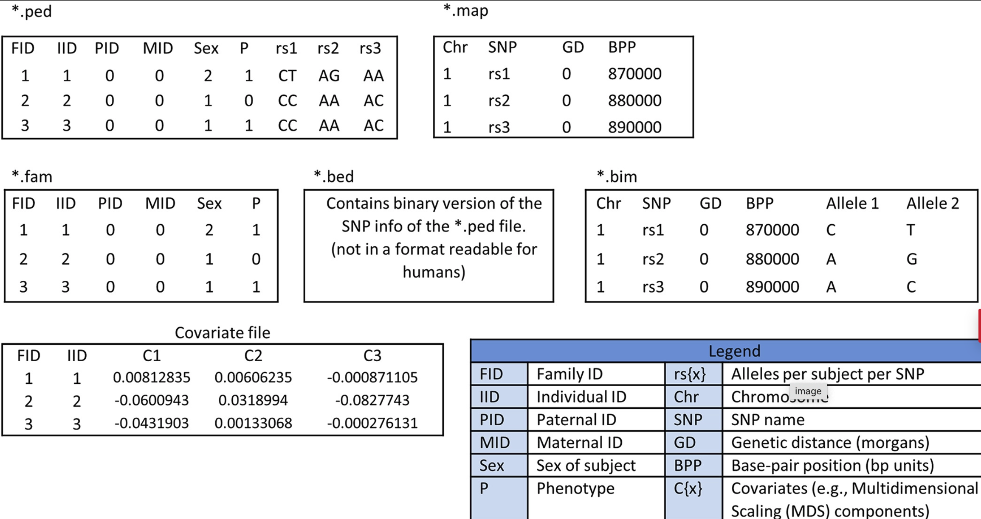
PLINK format

Slide 35
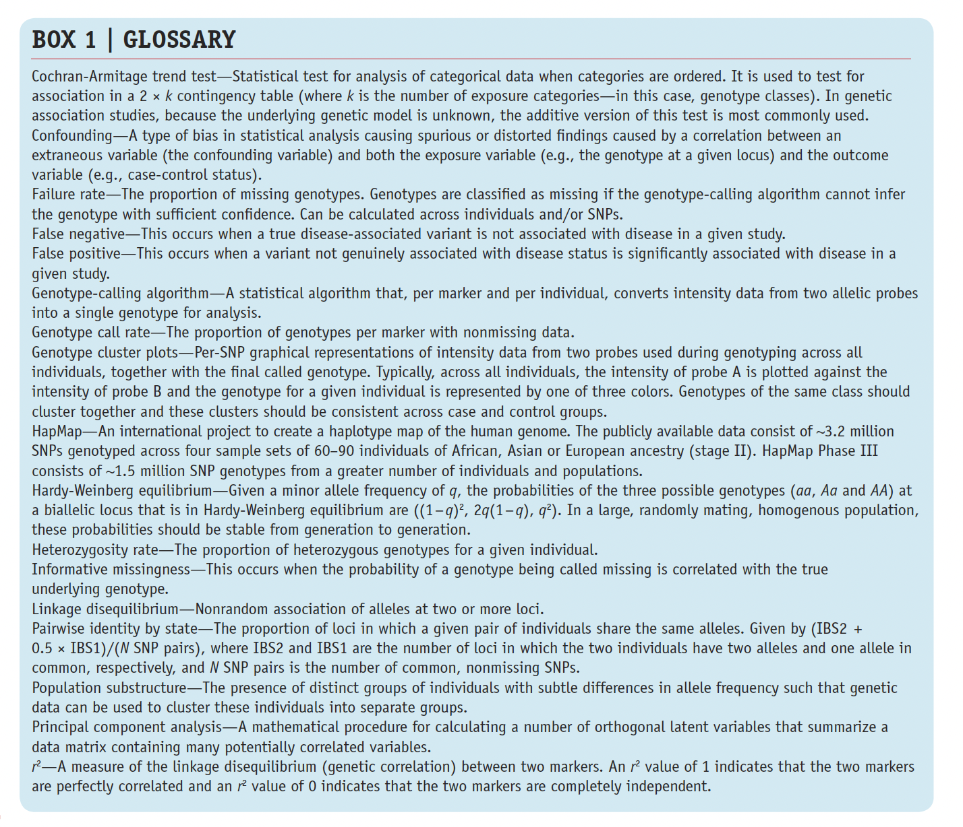
Some terms:
Anderson et al., 2014

Slide 36


Thank you guys!! See you tomorrow

